Slide 1
École Polytechnique de Montréal
Paper Presentation
2026.07.17 Meeting
Participant: Justin, Anum
MITACS Research Meeting · 2026
Quantum Computing and Genetic Algorithms for Software Testing

Slide 2
1
Paper 1 · Anomaly Detection in High-Energy Physics Using a Quantum Autoencoder

Slide 3
OVERVIEW
The complete story in one slide
What does this paper do?
1 · Problem
2 · Data
3 · Method
4 · Result
Unknown new physics cannot be covered exhaustively by signal-specific supervised learning.
Simulated LHC collision events are reduced to limited physically meaningful features.
Angle encode the vector, train a variational QAE, and force trash qubits toward |0…0⟩.
QAE beats the paper’s dense CAE baseline and is unusually data-efficient.
Core anomaly score
background-like event
→
trash fidelity F ≈ 1 anomaly score 1−F ≈ 0
|
anomalous event low F, high 1−F
MITACS Research Meeting
2

Slide 4
1 · MOTIVATION
Why anomaly detection is needed
Searching for new physics without knowing its shape
Observed situation
No confirmed new interaction or particle has emerged from LHC data.
Supervised
Model-agnostic (Unsupervised)
Limitation of supervised learning
Make assumption of a signal model -> Labeled signal data-> Train background vs. signal
Train on background only ->
Learn its kinematic structure
High anomaly score means “unlike background”
A classifier must be trained on a specific simulated signal hypothesis.
Paper’s response
Train only on Standard Model background and flag unfamiliar events.
We just want to find anomalous part; anomaly doesn't stand for new physics.
MITACS Research Meeting
3

Slide 5
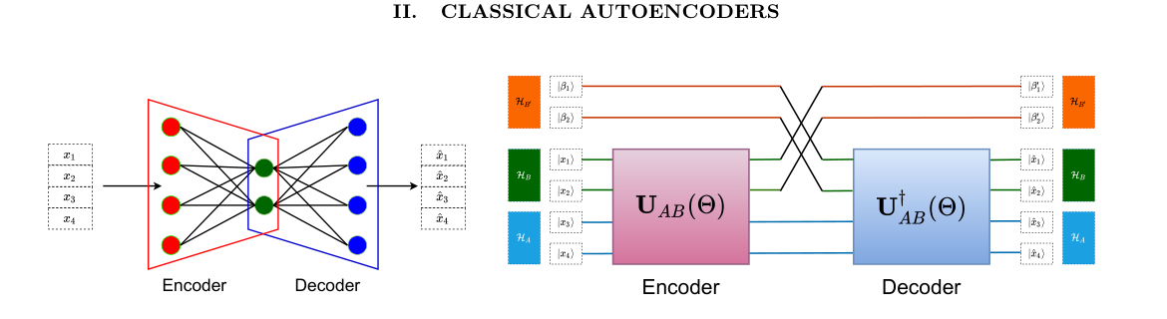
2 · ENCODER
Classical concept and quantum counterpart
How an autoencoder becomes an anomaly detector
Figure 1 compares the CAE and QAE bottlenecks.
Classical autoencoder
Quantum complication
x → encoder → low-dimensional latent z → decoder → reconstructed x̂
Unitary evolution preserves dimension, so a QAE must explicitly discard and replace trash qubits.
MITACS Research Meeting
4

Slide 6
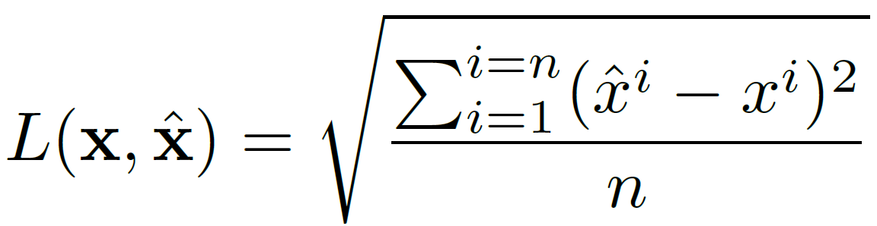
2 · ENCODER
Classical concept and quantum counterpart
How the classical autoencoder actually works
Input vector
Encoder
Latent code
Decoder
Reconstruction
x = physics features
E(ΘE, x)
z, k < n
D(ΘD, z)
x̂
Minimize reconstruction error RMSE
1 Train on background only
2 Background reconstructs well
3 Signal-like events fail
The model learns the kinematic distribution of Standard Model events.
If x follows the learned distribution, x̂ ≈ x and the loss is small.
A kinematically different event is reconstructed poorly, so loss becomes the anomaly score.
Many signals have a higher intrinsic dimension than background data due to their complexity
MITACS Research Meeting
5

Slide 7
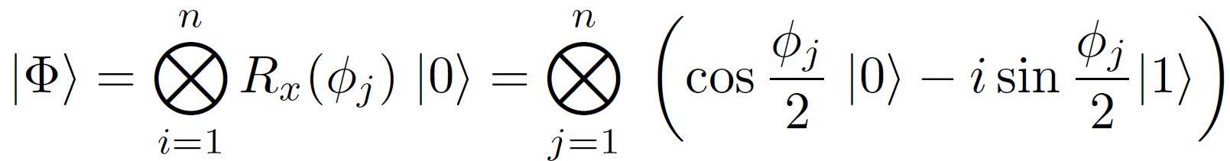
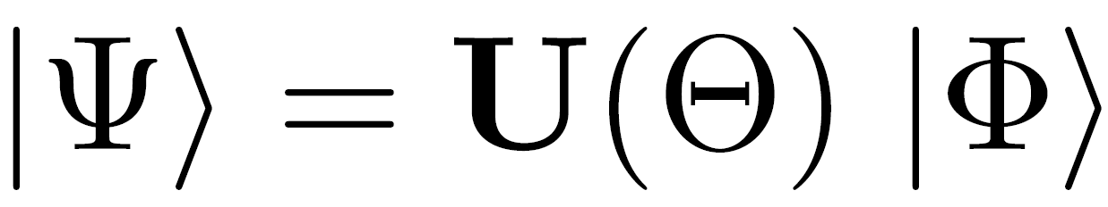
2 · ENCODER
Classical concept and quantum counterpart
How the quantum autoencoder actually works
1
Classical input
2
State prep.
3
Unitary circuit
4
Measure
5
Update
x = selected features
angle encoding
U(theta) evolves state
probabilistic shots
quantum gradient descent
Angle encoding: one feature → one qubit
Trainable evolution U(theta)
Measurement + training loop
Real-valued observable φj becomes an Rx rotation angle on the Bloch sphere.
After preparation, the parameterized circuit evolves the state:
Quantum measurement is probabilistic, so the same circuit is run many times.
shots -> estimate observable -> cost -> update theta
Input qubits are initially separable. CNOT gates create entanglement.
We use gradient descent to update parameters theta, with Fubini–Study metric according to quantum-state geometry.
n-dimensional input needs n qubits.
MITACS Research Meeting
6
Notes:
Narration for Section III: This section introduces the generic quantum machine learning pipeline. It has three blocks: state preparation, trainable unitary evolution, and measurement/postprocessing. First, classical real-valued inputs are encoded into qubits. In this paper, the method is angle encoding. Each feature value phi_j becomes the angle of an Rx rotation, so an n-dimensional input vector requires n qubits. This is why four selected physics features need four qubits. Second, the prepared state is evolved by a parameterized unitary circuit U(theta). The parameters theta are the trainable variables of the quantum model. Third, the final state is measured. Because quantum measurement is probabilistic, the circuit must be repeated many times, called shots, to estimate the observable accurately. Finally, after defining a cost function, the parameters are updated. The authors use quantum gradient descent, which uses the Fubini-Study metric so the optimizer follows the geometry of quantum states rather than assuming a simple Euclidean parameter space. The final point is entanglement: the input state after angle encoding is initially separable, so CNOT gates are needed later in the QAE circuit to let different feature qubits interact.

Slide 8
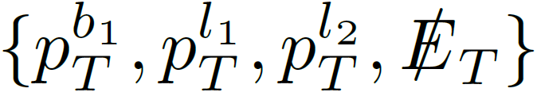

2 · ENCODER
Classical concept and quantum counterpart
Step 1 — Prepare the quantum input state
Classical event vector
Angle encoding
x =
After rescaling: each component becomes an angle in [0, pi].
n input dimensions require n qubits. , 4 features -> 4 input qubits.
Physical meaning of the quantum state
q0
stores angle of
q1
stores angle of
q2
stores angle of
q3
stores angle of
pT(b1)
pT(l1)
pT(l2)
MET
R_x(phi_1)|0>
R_x(phi_2)|0>
R_x(phi_3)|0>
R_x(phi_4)|0>
Immediately after angle encoding the state is separable: |Phi> = |phi1> ⊗ |phi2> ⊗ |phi3> ⊗ |phi4>. CNOT gates are needed later to entangle features.
MITACS Research Meeting
7
Notes:
This slide is the implementation of state preparation. The four physics observables are first rescaled to angles. Then each angle controls an R_x rotation on one qubit. The key implementation point is that this is angle encoding, not amplitude encoding. Because one feature maps to one qubit, the four-dimensional vector requires four qubits. The resulting state is separable at first; it only stores the four numbers independently. Entanglement is introduced later by the trainable QAE circuit.

Slide 9




2 · ENCODER
Classical concept and quantum counterpart
Step 2 — Build the bottleneck with latent, trash, and reference spaces
Hilbert-space split
A: latent qubits sent forward | B: trash qubits discarded | B′: fixed reference space
Implementation steps in the paper
1
Prepare composite input
3
Swap trash with reference
reference state beta is initialized as |0...0>
V_BB′ is the SWAP operation between B and B′
2
Encode only A+B
4
Optional decode
U_AB(theta) is the trainable variational circuit
decoder is the Hermitian conjugate of the encoder
Bottleneck: U is still dimension-preserving, so compression happens only because B is discarded and replaced by B′. If B already equals the reference, nothing important was thrown away.
MITACS Research Meeting
8

Slide 10
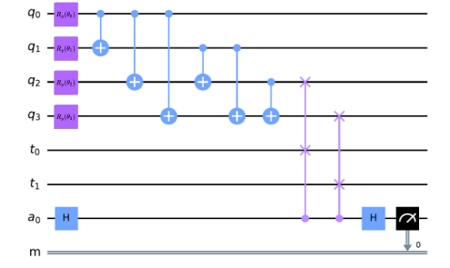



2 · ENCODER
Classical concept and quantum counterpart
Step 3 — Train the encoder by forcing trash qubits to become reference states
Perfect compression condition
Fidelity target
All useful information is in A; B contains no input information.
F = 1 means the trash output is exactly the fixed reference.
Training cost function
Negative sign converts “maximize fidelity” into a minimization problem. The ensemble is needed to estimate the network output, not just as a classical mini-batch.
Figure 2 circuit: embedded input qubits q_i → trainable R_y(theta_i) → CNOT entanglement → SWAP test against reference t_i and ancilla a_0.
Anomaly score
Qubit resources
s(x) = 1 − F
N_total = N_input + N_trash + 1
High fidelity -> background-like. Low fidelity -> hard to compress -> anomalous.
Example in Fig. 2: 4 input + 2 reference/trash + 1 ancilla = 7 total qubits.
MITACS Research Meeting
9
Notes:
This slide explains the actual training objective. The ideal encoder takes a background state and maps it into a compressed latent state in subsystem A while making the trash subsystem B equal to the fixed reference beta. In that case, replacing the trash with a fresh reference state loses no information. Therefore, instead of measuring full reconstruction fidelity, the authors train by maximizing trash-state fidelity. The cost is the negative average trash fidelity over the input ensemble. At test time, the anomaly score is 1 minus the fidelity. A high score means the event could not be compressed like the background.

Slide 11




3 · EXPERIMENT SETUP
From LHC simulation to anomaly score
End-to-end experimental workflow
1 simulate events
2 reconstruct objects
3 select physics features
4 rescale to angle range
5 QAE training
6 evaluate anomaly score
Two benchmarks
Benchmark 1 · Main experiment
Benchmark 2 · Cross-check experiment
Background: Signal: 4 input variables → 4 qubits Used for detailed training-size, ROC, significance, and hardware studies.
Background: Signal: 6 input variables → 6 qubits Used to test whether the QAE advantage carries to a different topology.
scalar dark-matter particle
Representation changes
detector-level event
→
reconstructed objects
→
classical vector x
→
angle vector φ ∈ [0,π]
→
quantum state |Φ(x)⟩
→
trash fidelity F
MITACS Research Meeting
10
Notes:
這頁是在把前面理論接到 實際 LHC 實驗資料流程。
它講的是：一個 collision event 最後怎麼變成 QAE 的 anomaly score。
整體流程
這頁上方有 6 個步驟：
1. simulate events
先用 Monte Carlo 模擬 LHC collision events。
例如 background 和 signal events。
2. reconstruct objects
把 detector-level information 重建成 physics objects，例如：
jets
leptons
missing transverse energy
3. select physics features
從重建後的 objects 中挑出少數有物理意義的 features。
不是把整個 raw detector data 丟進模型，而是先壓成 compact feature vector。
4. rescale to angle range
因為第一篇使用 angle encoding，所以 feature 要被 rescale 到：
[0,π][0,\pi][0,π]
變成 angle vector：
ϕ∈[0,π]\phi \in [0,\pi]ϕ∈[0,π]
5. QAE training
把 angle vector encode 成 quantum state，丟進 QAE。
QAE 用 background-only data 訓練，讓 trash fidelity 變高。
6. evaluate anomaly score
最後用：
s(x)=1−Fs(x)=1-Fs(x)=1−F
得到 anomaly score。
兩個 benchmark
這頁下面列出兩個實驗。
Benchmark 1：Main experiment
Background：
pp→ttˉpp\to t\bar{t}pp→ttˉ
Signal：
pp→H→ttˉpp\to H\to t\bar{t}pp→H→ttˉ
這個 case 用：
4 input variables→4 qubits4 \text{ input variables} \rightarrow 4 \text{ qubits}4 input variables→4 qubits
它是主要實驗，用來做：
training-size analysis
ROC
significance
hardware studies
Benchmark 2：Cross-check experiment
Background：
pp→Z(ννˉ)jjpp\to Z(\nu\bar{\nu})jjpp→Z(ννˉ)jj
Signal：
pp→hjj,h→SSpp\to hjj,\quad h\to SSpp→hjj,h→SS
這個 case 用：
6 input variables→6 qubits6 \text{ input variables} \rightarrow 6 \text{ qubits}6 input variables→6 qubits
它的作用是確認 QAE 的效果不是只對 ttˉt\bar{t}ttˉ final state 有效，而是在另一種 topology 下也能成立。

Slide 12

4 · DATA SIMULATION
Main benchmark: resonant Higgs over tt̄ background
Experiment 1
Physics processes
Event generation chain
Dataset size
Object cuts
Background: Signal: √s = 14 TeV mH = 1.0, 1.5, 2.0, 2.5 TeV
MadGraph5_aMC@NLO → Pythia8 → Delphes3 → FastJet Hard scattering → shower/hadronization → detector → jets
Background ≈30k 10k train · 5k validation · 15k test Signal ≈15k per mass
anti-kₜ jets, R = 0.5 b-jets: pₜᵇ > 30 GeV muons: pₜˡ > 30 GeV isolation R = 0.5
Decay and reconstruction logic
Final 4D vector passed to the scaler
H → t t̄, t → bW, W → μν
The analysis focuses on the muon channel. The reconstructed b-jet, two muons, and missing transverse energy become the compact event description.
pₜᵇ¹
pₜˡ¹
leading b-jet transverse momentum
highest-pₜ muon
pₜˡ²
E̸ₜ
second-highest-pₜ muon
missing transverse energy from invisible recoil
Data simulation emphasis: raw detector information is not used directly. The paper first compresses each event into a small, physically interpretable vector before any quantum encoding.
MITACS Research Meeting
11

Slide 13



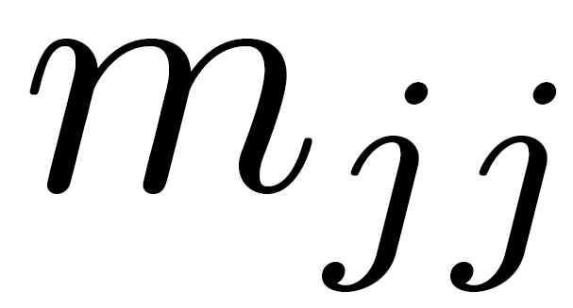
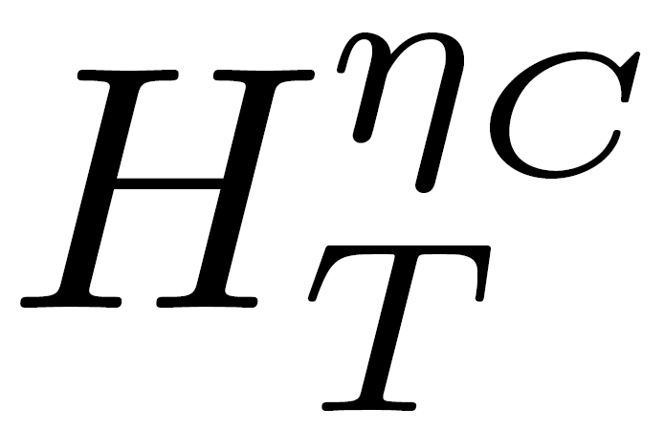
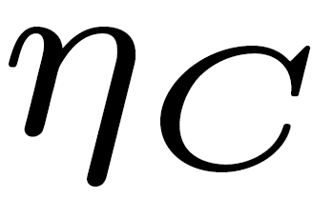
4 · DATA SIMULATION
Main benchmark: resonant Higgs over tt̄ background
Experiment 2
Physics processes
Generation and cuts
Dataset size
Purpose
Background: Signal: The Higgs decays invisibly to scalar dark matter particles.
Same simulation chain as Experiment 1 ≥2 jets with pₜ > 30 GeV missing transverse momentum > 30 GeV
Background: 30k 10k train · 5k validation · 15k test Signal: 15k test
This benchmark checks that the QAE behavior is not specific to the tt̄ final state.
Six-dimensional event vector
Feature meanings
• : separation in pseudorapidity between the two leading jets • : invariant mass of the dijet system • : transverse-energy sum inside a central pseudorapidity window • The different values probe how central or forward the transverse activity is
Mapping note: the paper again uses angular embedding. For this case the feature ranges are extended on the high side so that the non-periodic variables are not wrapped into equivalent angles.
MITACS Research Meeting
12

Slide 14
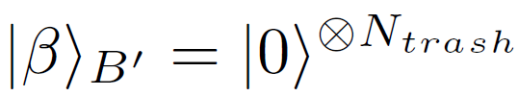

5 · SHARED QAE PIPELINE
Same model workflow for both benchmarks
How the same QAE is trained and evaluated
Training target: make trash look like reference
Testing target: anomaly score
s(x) = 1 − F(|β⟩, ρ̂_trash)
C(Θ) = − Σ_i p_i F(|β⟩_{B′}, ρ̂_B′)
Background-like
Anomalous
trash ≈ |0…0⟩ F ≈ 1 s(x) ≈ 0
trash not close to reference F low s(x) high
The negative sign converts “maximize trash fidelity” into a minimization problem. A perfect reconstruction is possible when trash fidelity equals 1.
SWAP-test resources
Iteration loop
initialize Θ
encode event
run shots
estimate F
update Θ
Example: 4 input qubits + 2 reference/trash qubits + 1 ancilla = 7 total qubits.
→
→
→
→
The paper trains and tests using only the encoder circuit, because trash fidelity acts as a proxy for reconstruction quality.
MITACS Research Meeting
13

Slide 15

6 · TRAINING DETAILS
Numbers required to reproduce the experiment
Optimization settings and classical baseline
QAE training schedule
Train events
Epochs
Updates
Quantum-gradient descent
QAE fixed settings
1
500
500
G is the Fubini–Study metric; the update respects quantum-state geometry.
5,000 shots per circuit evaluation Weights updated for each data sample Latent dimensions: 1, 2, 3
10
200
2,000
100
50
5,000
1,000
50
50,000
10,000
50
500,000
Classical autoencoder baseline
Dense CAE used for comparison
Why this comparison matters
Encoder: input → 20 → 15 → 10 → latent Decoder: symmetric architecture Hidden activation: ReLU; latent activation: Linear Optimizer: Adam; learning rate: 10⁻³ Loss: RMSE; batch size: 64 Parameters: O(1000)
The QAE uses the same input variables as the CAE, but has only O(10) trainable parameters. The paper is testing whether a shallow variational quantum circuit can learn a useful background compression with far fewer parameters.
MITACS Research Meeting
14
Notes:
This slide summarizes the optimization settings. For the QAE, the authors train different latent dimensions, 1, 2, and 3, and different training sizes from 1 to 10,000 events. Each circuit evaluation uses 5000 shots, and the parameters are updated for each data sample. The optimizer is quantum-gradient descent, which uses the Fubini–Study metric to account for the geometry of the quantum state space.
For comparison, the CAE baseline is a dense autoencoder with hidden layers 20, 15, and 10, trained with Adam and RMSE loss. The important point is that both models use the same input variables, but the QAE has only O(10)O(10)O(10) trainable parameters while the CAE has O(1000)

Slide 16
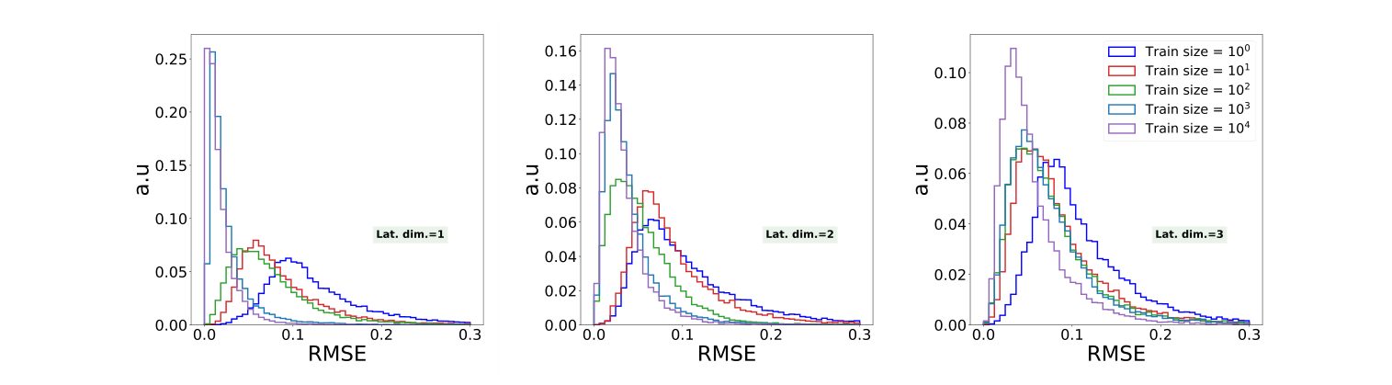
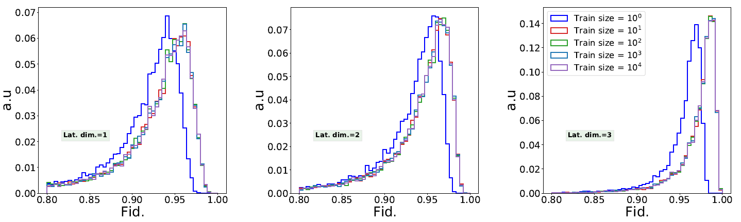
7 · RESULTS
Evidence 1: training-size dependence
QAE learns from much smaller background samples
CAE: test RMSE distribution shifts strongly with more data
QAE: test fidelity stabilizes after about 10 events
Classical behavior
Quantum behavior
Interpretation
Efficient reconstruction needs roughly ≥10³ training samples; small samples show high uncertainty and poor generalization.
One training event does not fully converge, but from 10 events upward the fidelity distributions become nearly identical.
The authors suggest the simple circuit, measurement statistics, and quantum gradient descent may explain this small-sample efficiency.
This is the first major empirical claim: in the studied LHC benchmark, the QAE is much less dependent on training sample size than the dense CAE.
MITACS Research Meeting
15
Notes:
This slide compares how much training data the CAE and QAE need. For the CAE, the RMSE distribution shifts strongly to the left as the training size increases, meaning that the classical autoencoder needs more data to reconstruct background events well. The authors suggest that efficient reconstruction requires roughly 10310^3103 samples.
In contrast, the QAE fidelity distribution becomes almost stable after about 10 training events. Since higher fidelity means the trash state is close to the reference state, this indicates that the QAE learns the background compression with far fewer samples. This is one of the main empirical claims of the paper.

Slide 17
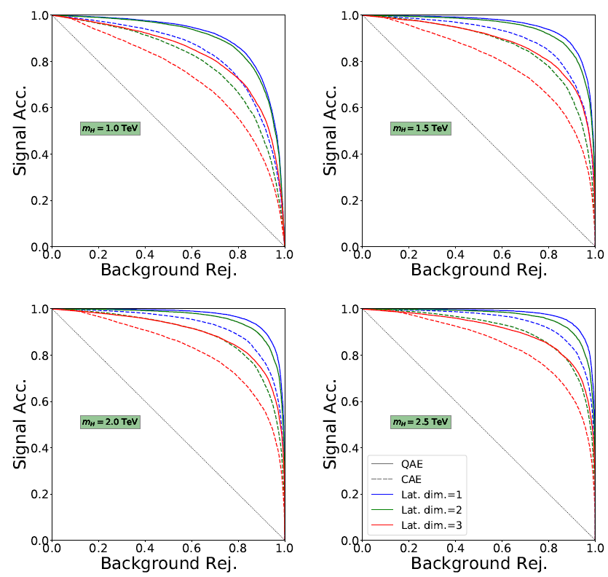
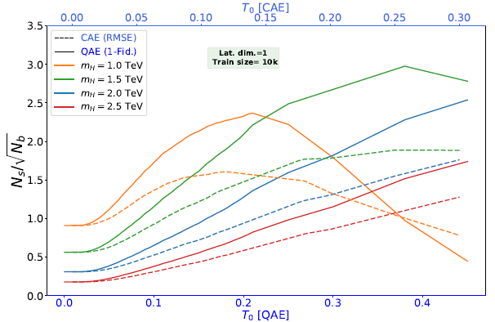
7 · RESULTS
Evidence 2: anomaly discrimination
QAE beats the dense CAE on ROC and significance
ROC curves
Bottleneck effect
Significance
For mH = 1.0, 1.5, 2.0, and 2.5 TeV, QAE curves lie above CAE curves for all tested latent dimensions.
The smallest latent dimension gives the strongest background rejection. Strong compression makes signal-like events harder to pass through.
Using 1−F for QAE and RMSE for CAE, the peak N_S/√N_B is higher for QAE under σ_S = 10 fb and L = 3000 fb⁻¹.
The paper stresses that these metrics compare classifiers; the real LHC background rate remains much larger than the benchmark signal rate.
MITACS Research Meeting
16
Notes:
This slide shows that the QAE is not only more data-efficient but also gives better anomaly detection performance. On the left, the ROC curves compare signal acceptance and background rejection for four heavy Higgs masses. The solid QAE curves lie above the dashed CAE curves for all tested masses and latent dimensions, meaning that QAE has better discrimination.
The smallest latent dimension gives the strongest bottleneck and usually the best background rejection, because signal-like events are harder to compress through such a narrow latent space. On the right, the significance plot shows that using 1−F1-F1−F for QAE gives a higher peak NS/NBN_S/\sqrt{N_B}NS​/NB​​ than using RMSE for CAE, under the assumed signal cross-section and luminosity.

Slide 18
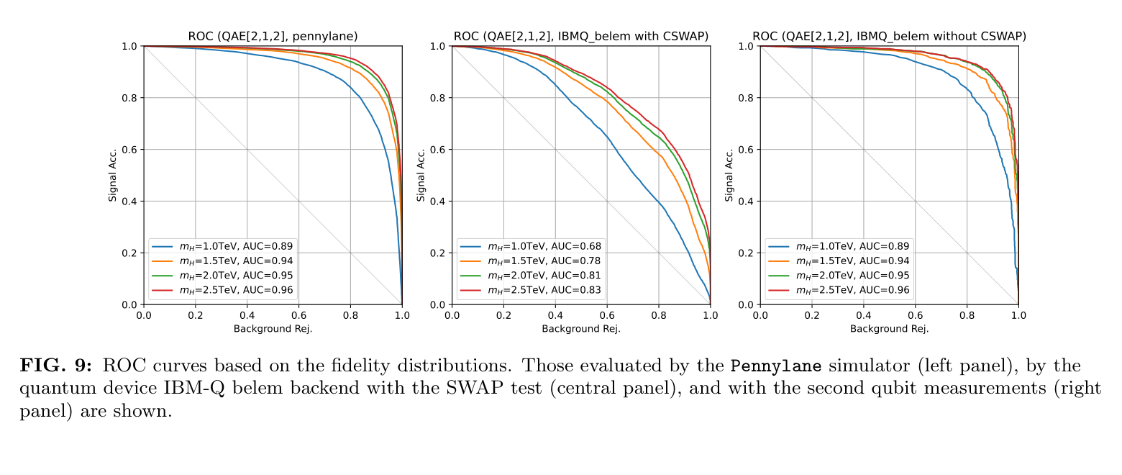
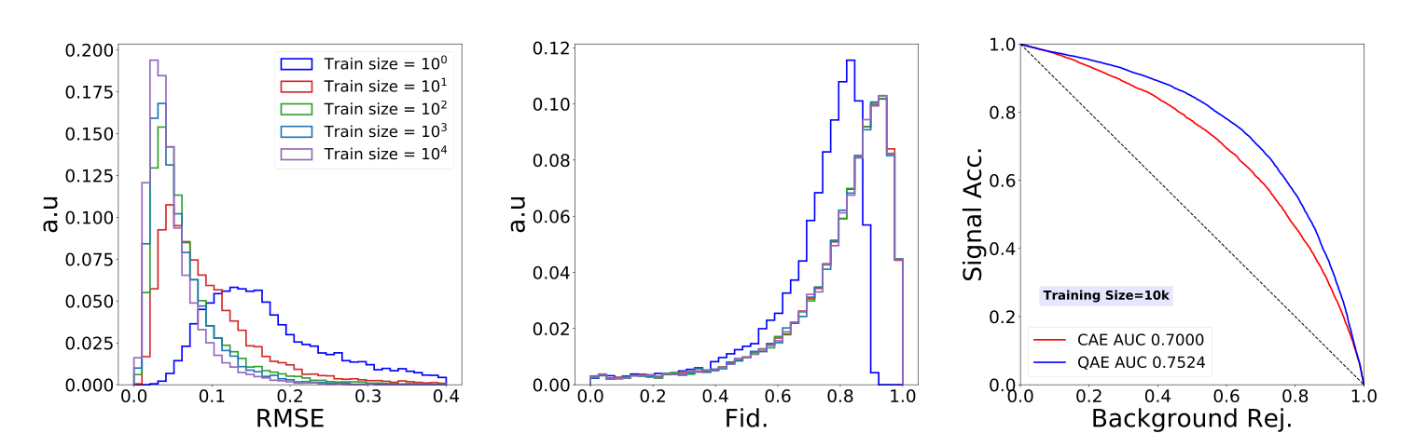
7 · RESULTS
Evidence 3: robustness checks
Hardware benchmark and second physical signature
IBM-Q hardware lesson
Second benchmark lesson
The 2-input QAE is tested on IBMQ Belem. The SWAP-test version loses AUC because CSWAP is too deep and decoheres. Direct Pauli-Z trash measurement reproduces simulator AUC almost exactly.
For invisible Z background vs invisible Higgs signal, the QAE again converges with smaller data and outperforms the optimized dense CAE: QAE AUC = 0.7524 vs CAE AUC = 0.7000.
Together, these checks support the authors’ claim that the behavior is not just a one-process artifact and that shallow measurement design is critical on NISQ devices.
MITACS Research Meeting
17

Slide 19
2
Paper 2 · Applying Quantum Autoencoders for Time Series Anomaly Detection

Slide 20
OVERVIEW
The complete story in one slide
What does this paper do?
1 · Research goal
2 · Data preparation
3 · Encoding focus
4 · Experiments
Apply quantum autoencoders to time-series anomaly detection where training data contains only normal behavior.
Use UCR univariate time series; cut each signal into 128-point sliding windows with stride 1.
Convert each 128-value window into a 7-qubit quantum state using amplitude encoding; use quasi-amplitude encoding on hardware.
Compare MSE reconstruction and Swap-Test latent analysis in simulation, then run a reduced setup on IBM Torino.
Core pipeline studied in the paper
raw time series
→
128-point window
→
7-qubit amplitude state
→
latent + trash QAE
→
MSE / Swap score
MITACS Research Meeting
18

Slide 21
1 · MOTIVATION
Why time-series anomaly detection is difficult
Research motivation and question
Problem setting
Why time context matters
Paper’s goal
Anomalies are rare; many benchmarks provide normal training data and place the only anomaly in the test series.
A value can look normal by itself but become anomalous within a local temporal pattern or over a longer segment.
Evaluate whether QAE can detect anomalies in time windows and run on real NISQ hardware.
The paper studies two anomaly scores
Reconstruction error
Latent representation analysis
Run encoder → reset trash → Encoder† and compute MSE between input and reconstructed window.
Skip reconstruction and use the Swap-Test measurement: if trash differs from |0⟩, the window compresses poorly.
Main research question: can a small QAE learn normal time-series structure from benign windows and separate unseen anomalous windows?
MITACS Research Meeting
19

Slide 22
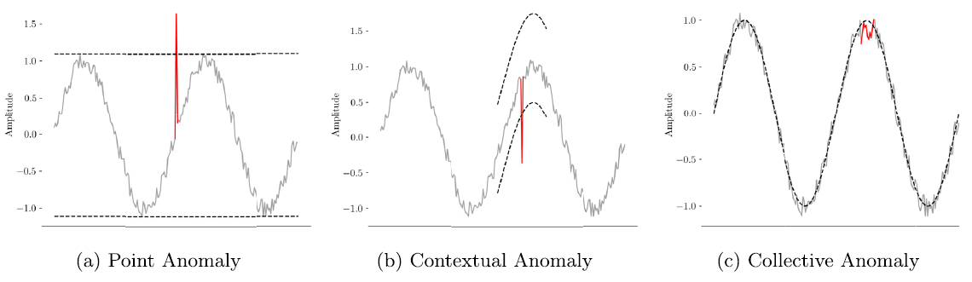
2 · DATA AND TOOLS
Classical data source and software stack
What data and tools did they use?
Figure 1: anomaly taxonomy; Fig. 4 in the paper shows the six selected UCR datasets and their red anomaly ranges.
Data source
Datasets and tools
Labels and split
UCR Time Series Anomaly Archive. Domains include medicine, sports, industry, robotics, space science, and more.
Simulator datasets: 28, 54, 99, 118, 138, 176.
Tools: PyTorch baseline; Qiskit 1.0.0 + Aer 0.13.1; COBYLA; EfficientSU2 + IBM Torino hardware run.
Training series contains only benign values; each test series has a single anomaly range. Detection is valid if the selected window starts in the valid detection range.
MITACS Research Meeting
20

Slide 23
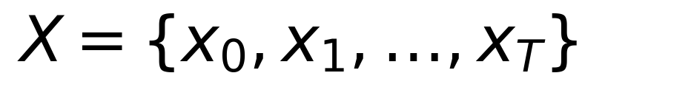
3 · PREPROCESSING
Raw time series → fixed-size input samples
Step 1 — Construct sliding windows
Raw univariate time series
Window definition used by the paper
Each xᵢ is one scalar value: a sensor reading, signal amplitude, physiological value, etc.
window size
stride
input sample
count
128 points matches 2⁷ amplitudes
1 windows overlap heavily
one window not one time point
T−127 windows from T points
Important detail: the paper does not normalize the raw series before windowing; normalization is performed during quantum state preparation.
MITACS Research Meeting
21

Slide 24
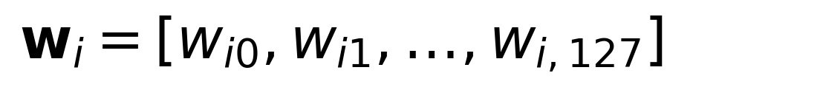
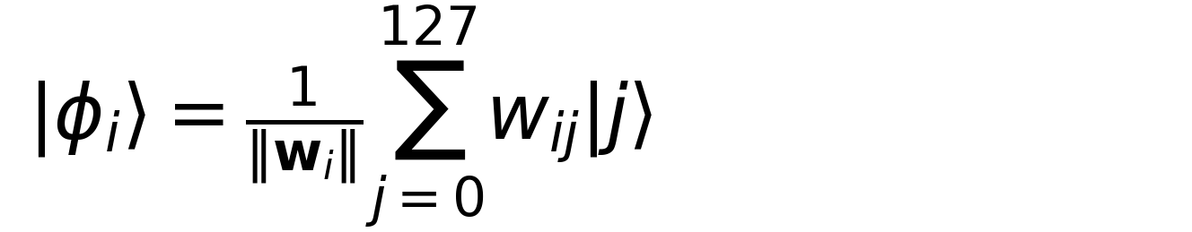
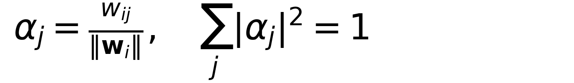
3 · STATE PREPARATION
Classical window → quantum state
Step 2 — Amplitude encoding into 7 qubits
For each 128-point window
Why 7 qubits?
A K-qubit state has 2ᴷ computational basis amplitudes. Since 2⁷ = 128, one full window fits into 7 qubits.
State preparation formula
Basis-state mapping
wᵢ₀ → amplitude of |0000000⟩; wᵢ,₁₂₇ → amplitude of |1111111⟩.
Important consequence
The vector norm is divided out. The state mainly preserves relative shape; absolute scale may be lost unless treated separately.
Amplitude encoding is qubit-efficient: N values require log₂(N) qubits. It is not necessarily hardware-efficient.
MITACS Research Meeting
22

Slide 25
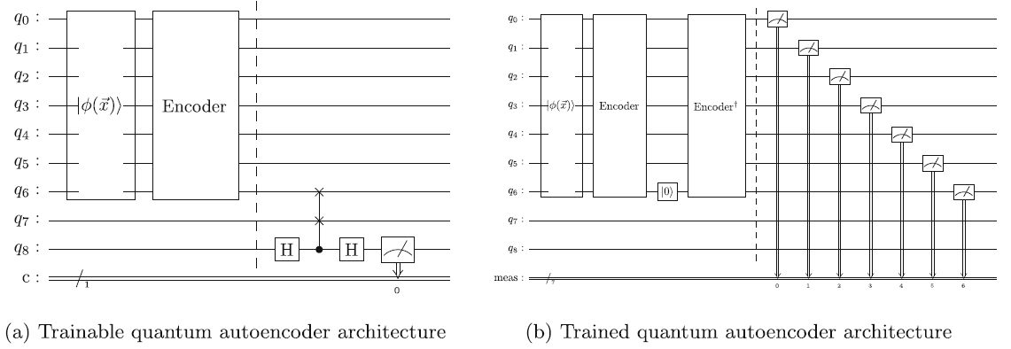
3 · AUTOENCODING
Compressing a quantum time-window state
Step 3 — QAE encoder, latent qubits, and trash qubit
7-qubit autoencoder
Compression target
q₀–q₅ are the 6-qubit latent space; q₆ is the trash qubit.
After the encoder, q₆ should be close to |0⟩, meaning all useful information has moved into q₀–q₅.
Training circuit
Decoder
Training adds q₇ = |0⟩ as reference and q₈ as Swap-Test ancilla, so the training circuit uses 9 qubits.
For reconstruction, the decoder is Encoder† after resetting q₆. It is not trained separately.
Fig. 2: training circuit uses Swap-Test; final reconstruction circuit uses Encoder† after resetting the trash qubit.
MITACS Research Meeting
23

Slide 26
4 · EXPERIMENT SETUP
Simulation experiment from Sections 4.1–4.3
Data, ansätze, optimizer, and classical baseline
Ansätze tested
Data
QAE size
Six UCR datasets: 28, 54, 99, 118, 138, 176. Window size = 128, stride = 1.
7 data qubits; 9 training qubits; 6 latent qubits; 1 trash qubit.
• RealAmplitudes: alternating RY rotations and CX entanglement • Entanglement patterns: circular, full, linear, SCA • PauliTwoDesign: Pauli rotations + pairwise CZ gates • Depth 2–10 → 21–77 trainable parameters
Classical baseline
Training
Execution
COBYLA optimizer, default settings, 45 iterations, 5,000 shots.
Qiskit 1.0.0 + Qiskit Aer 0.13.1; statevector simulator; 16 Intel Broadwell CPU cores; COBYLA optimizer.
• LSTM autoencoder, input dimension = 128 • Latent dimension = 4 • Batch size = 150, Adam optimizer • 250 epochs, 4,686 trainable parameters • Anomaly score = reconstruction MSE
The paper averages each quantum ansatz configuration over 5 executions.
MITACS Research Meeting
24
Notes:
COBYLA 是一種 derivative-free optimizer，也就是不需要直接算 gradient。
訓練設定是：
iterations45 shots5000
shots 的意思是同一個 quantum circuit 重複測量很多次，因為 quantum measurement 是 probabilistic，需要靠多次測量估計結果。
訓練目標是讓 QAE 對 normal time windows 能夠壓縮得好。具體來說，就是讓 trash qubit 越接近 reference qubit ∣0⟩|0\rangle∣0⟩，Swap-Test 測到異常訊號的比例越低。

Slide 27
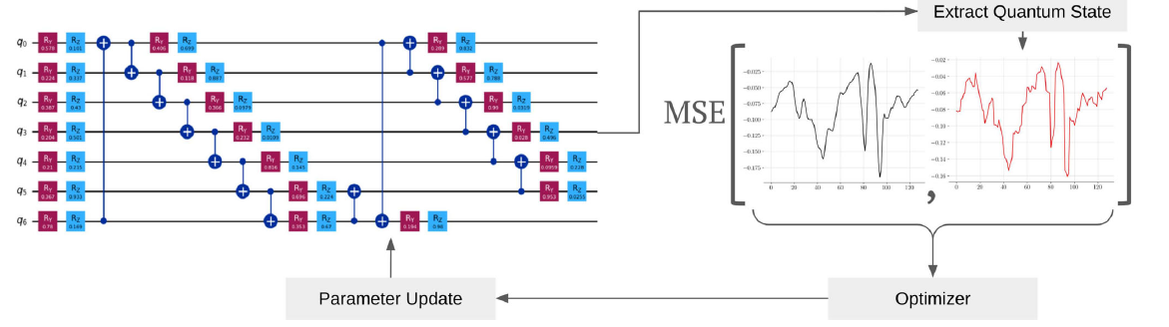
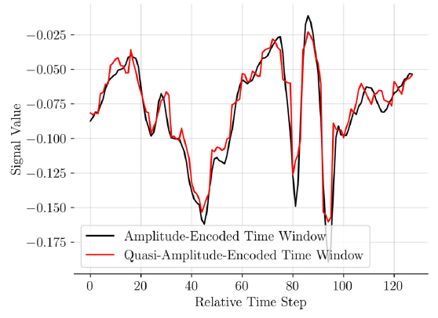
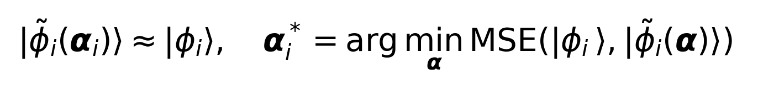
4 · QUASI-AMPLITUDE ENCODING
Exact amplitude encoding is replaced by a shallow variational state-prep circuit
How classical windows become hardware-ready quantum circuits
Two parameter sets must not be confused
Quasi-encoding procedure
Input-specific αᵢ
1. Target state: exact amplitude-encoded |ϕᵢ⟩ 2. Use EfficientSU2 with 7 qubits and 2 repetitions 3. Extract generated quantum state 4. Compute MSE to target state 5. SPSA updates state-prep parameters 6. Repeat 100 trials per window and keep the lowest-MSE circuit
EfficientSU2 parameters encode one particular window; fixed during QAE training.
Model parameters θ
PauliTwoDesign QAE encoder parameters are shared and optimized during training.
MITACS Research Meeting
25
Notes:
在真實 IBM hardware 上，要精準準備這個任意 quantum state，circuit 會非常深。經過 transpilation 之後 gate 數變很多，容易 decoherence，所以 measurement 不可靠。
所以 hardware 上改用 quasi-amplitude encoding 他們不再精準準備 exact amplitude-encoded state，而是用一個比較淺的 variational circuit 產生近似 state：這個 circuit 使用 EfficientSU2，有 7 qubits 和 2 repetitions。
你可以看到紅線沒有完全等於黑線，但大致跟得上 shape。
quasi-amplitude encoding 不是完美重建，但保留了 time window 的主要形狀。\boxed{ \text{quasi-amplitude encoding 不是完美重建，但保留了 time window 的主要形狀。} }quasi-amplitude encoding 不是完美重建，但保留了 time window 的主要形狀。

Slide 28
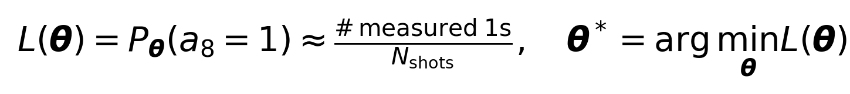
4 · TRAINING
What is trained after the data are encoded?
QAE encoder training loop and optimizer
The model trains the encoder ansatz parameters θ
Optimizer
This paper uses COBYLA with default parameters, not gradient descent. COBYLA is derivative-free.
Training objective
Hardware-specific settings
Minimize the probability that the Swap-Test ancilla is measured as 1.
Dataset 54; 150 training windows; PauliTwoDesign with 2 repetitions; 21 trainable parameters; 45 epochs; 8,192 shots on IBM Torino.
MITACS Research Meeting
26

Slide 29
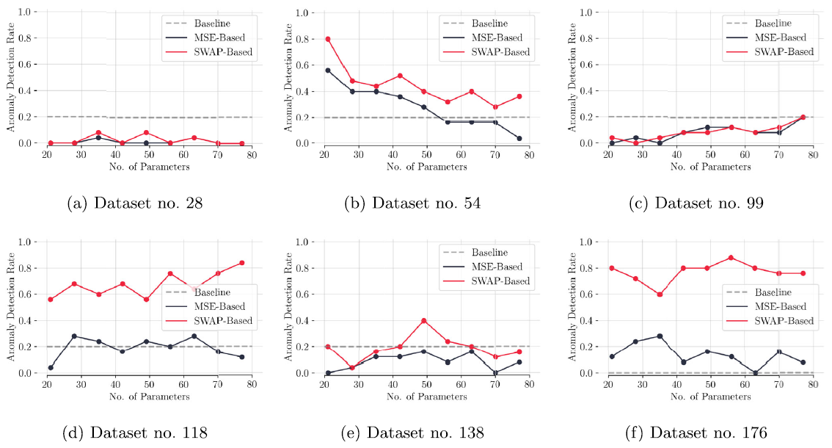
5 · RESULTS
Simulation experiment: six UCR datasets
Detection performance across ansätze and datasets
Key claim
Important nuance
Parameter efficiency
For each dataset, at least one QAE configuration outperforms the LSTM baseline.
Not every ansatz works; many settings fail, especially on datasets 28 and 99.
QAE: 21–77 parameters; 45 iterations, 250 epochs.
baseline: 4,686 parameters; QAE uses
Fig. 4 shows the six datasets. Fig. 11 compares average detection rates for MSE-based and Swap-based methods against the baseline.
MITACS Research Meeting
27
Notes:
灰色虛線：Baseline
這是 classical LSTM autoencoder 的表現。
如果 QAE 曲線高於灰色 baseline，代表 QAE 比 LSTM baseline 好。
黑線：MSE-Based
這是 QAE 用 reconstruction error 做 anomaly score。
MSE 越大，越可能是 anomaly。
這個方法比較像 classical autoencoder。
紅線：SWAP-Based
這是 QAE 用 Swap-Test latent analysis 做 anomaly score。
如果 trash qubit 跟 ∣0⟩ 差很多，代表這個 window 壓縮不好，可能是 anomaly。
主要觀察 1：SWAP-Based 通常比 MSE-Based 好
你可以看到很多 dataset 裡，紅線比黑線高。
這表示：
直接看 latent/trash compression quality，常常比完整 reconstruction 更有效。
原因是 MSE 要重建整個 128-point window，要求很高；只要 reconstruction 有 noise，就可能影響 anomaly score。但 SWAP-Based 只問一件事：這個 window 的資訊能不能被壓進 latent qubits，讓 trash qubit 接近 ∣0⟩？這比較直接對應 QAE 的訓練目標。

Slide 30
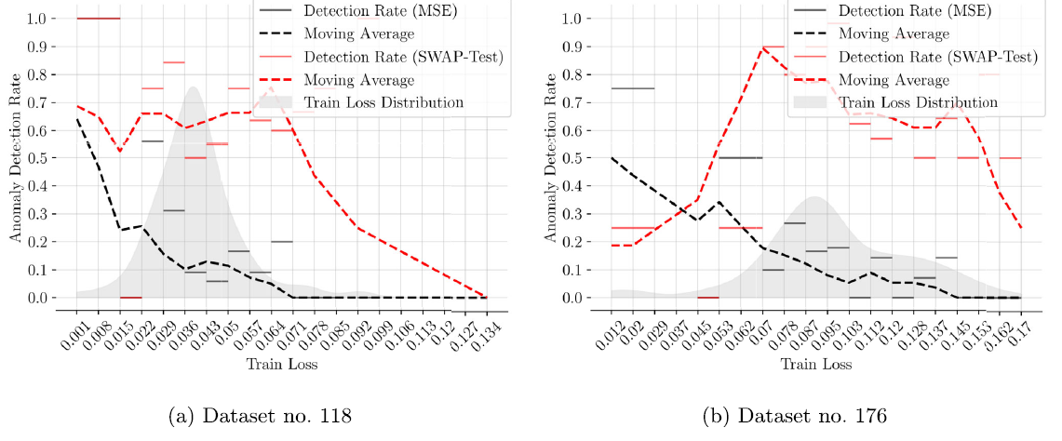
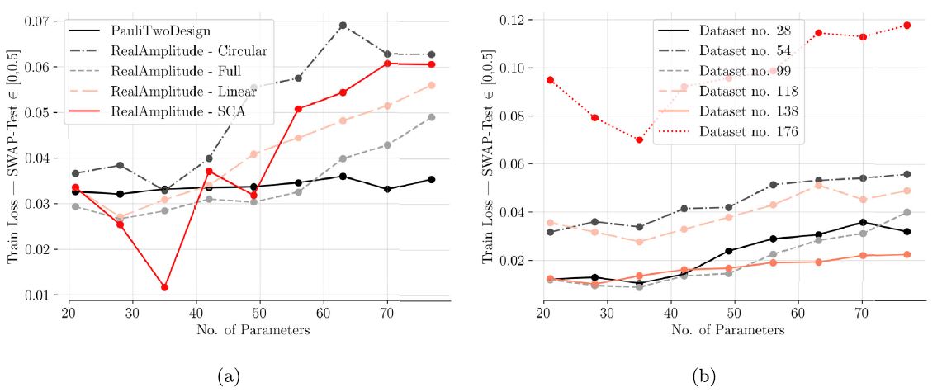
5 · RESULTS
Why the score and ansatz matter
Swap-Test vs. MSE and training complexity
Swap-Test strength
MSE strength
Ansatz complexity
More robust at higher training loss; especially helpful when anomalies are subtle and reconstruction noise is misleading.
Can be better at very low loss, but requires extremely accurate reconstruction of all 128 values.
More parameters often increase training loss with COBYLA; PauliTwoDesign remains more stable.
The paper’s practical message: ansatz selection and scoring method are not secondary details—they determine whether the QAE detects anomalies.
MITACS Research Meeting
28
Notes:
這頁是在解釋：為什麼同樣都是 QAE，有些設定會偵測得好，有些設定會失敗。
它主要在比較三件事：
anomaly score 的選擇、training loss、ansatz complexity
QAE 的表現不是只看「是不是量子模型」，而是很依賴 用 Swap-Test 還是 MSE 當 anomaly score，以及 ansatz 架構和參數量是否適合訓練。
為什麼 Swap-Test 有時比較強？
這頁下面寫 Swap-Test strength：More robust at higher training loss.
意思是： 就算 QAE 沒有訓練到非常低的 loss，Swap-Test score 還是可能抓到 anomaly。原因是 Swap-Test 不需要重建完整 128 個數值，它只看：
這個 window 能不能被 encoder 壓進 latent space 所以它比較接近 QAE 的 training objective。
對 subtle anomaly 來說，如果 reconstruction 本身有 noise，MSE 可能被干擾；但 Swap-Test 可以直接看 latent compression 是否異常。
MSE 的優點和缺點
MSE-based 的優點是：如果 reconstruction 做得非常準，它可以很直觀地找出重建不好的 anomaly。
但缺點是它需要完整還原：128 values 也就是整個 time window。
所以只要 decoder reconstruction 稍微有 noise，MSE anomaly score 就可能不穩。
右邊兩張圖：ansatz complexity
右邊兩張圖是在看：parameters 數量對：training loss 的影響。
重點是：參數越多不一定越好。
理論上，ansatz deeper、parameters 更多，模型表達能力可能更強。但實際上用 COBYLA 訓練時，參數太多可能更難 optimize，training loss 反而上升。ansatz selection 是核心設計選擇，不是小細節。

Slide 31
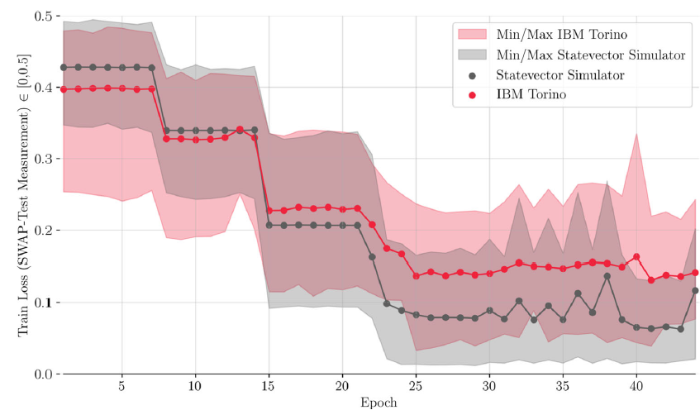
5 · RESULTS
Runtime, cost, and practical limitations
Execution cost on real quantum hardware
Per-epoch time
Each epoch required ≈7 min of quantum computing time and ≈11 min elapsed time.
Per experiment
One real-hardware experiment consumed ≈5.25 h quantum time and took ≈8.25 h to complete.
Total study cost
The study used ≈21 h quantum computing time; pay-as-you-go estimate: $120,960.
Interpretation
QAE uses fewer parameters, but current hardware execution is still expensive and not faster in practice.
Fig. 16 compares training loss on IBM Torino and the statevector simulator. Simulator loss falls faster; hardware loss is noisier but still converges.
MITACS Research Meeting
29
Notes:
雖然 QAE 參數少，但在真正 quantum hardware 上跑，時間成本和金錢成本都非常高。
QAE 在模型參數上很省，但目前真實量子硬體執行很慢、很貴，所以還沒有實務速度優勢。
左邊圖是比較 IBM Torino real quantum hardware 和 statevector simulator 的 training loss。
橫軸是：Epoch 縱軸是：Train Loss 也就是 Swap-Test measurement 的 loss。loss 越低，代表 trash qubit 越接近 reference ∣0⟩，QAE 壓縮 normal windows 的效果越好。圖中的灰色是 simulator，紅色是 IBM Torino。
圖的重點
1. Simulator loss 掉得比較快
灰色 simulator 的 loss 下降比較快，也比較低。
這很合理，因為 simulator 沒有真實硬體 noise。
2. IBM Torino loss 比較 noisy
紅色 IBM Torino 的 loss 也有下降，但波動比較大，而且最後 loss 比 simulator 高。
3. 但 hardware 還是有收斂
雖然 IBM Torino 比 simulator noisy，但紅色曲線仍然從約 0.4 降到約 0.14 左右。
所以作者想表達：real hardware 比 simulator 差，但仍然可以訓練出可用的 QAE。

